Slide 1
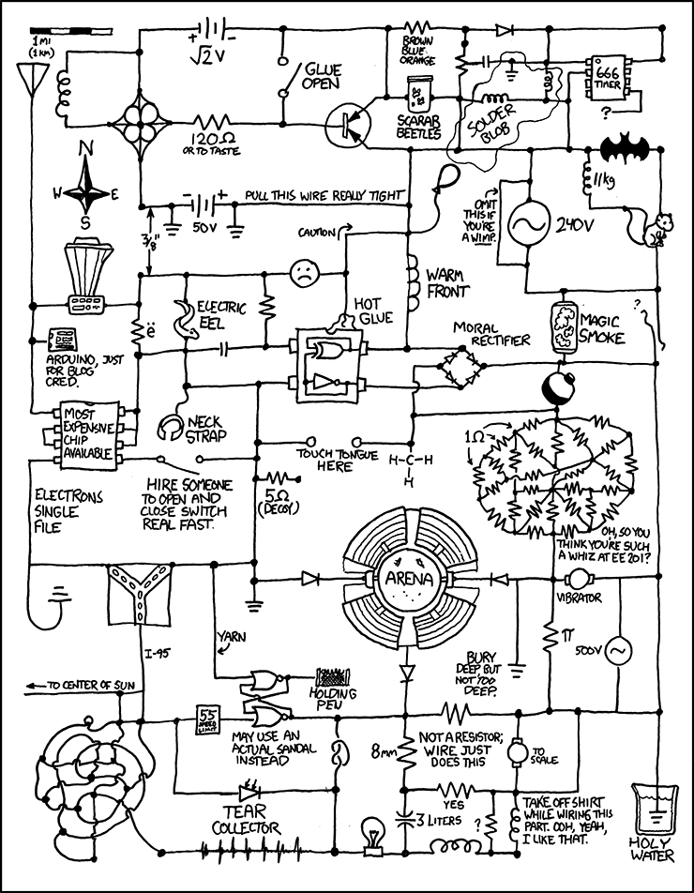
Schematics to Breadboards
Sept-2019

Slide 2
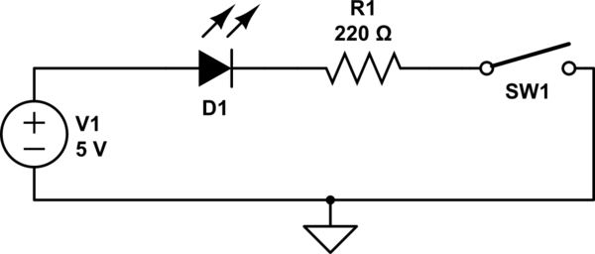
What’s a Schematic?
A diagram showing electrical components and their connections

Slide 3
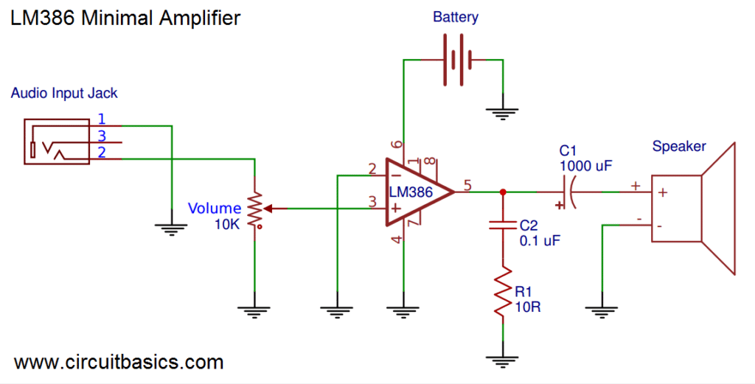
Drawn from logical/signal flow point of view

Slide 4
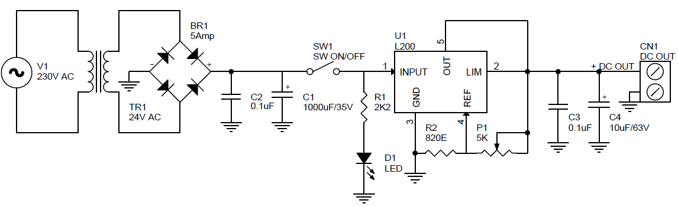
Power Supply

Slide 5
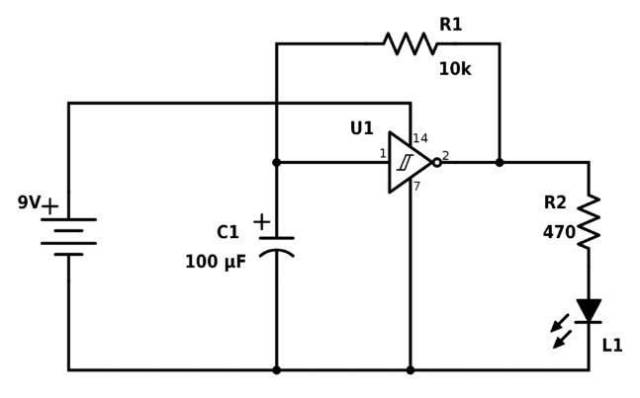
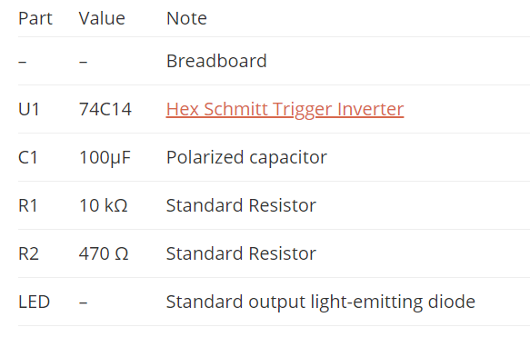

Schematic Usually has a BOM
Source: https://www.build-electronic-circuits.com/build-blinking-light-circuit/

Slide 6
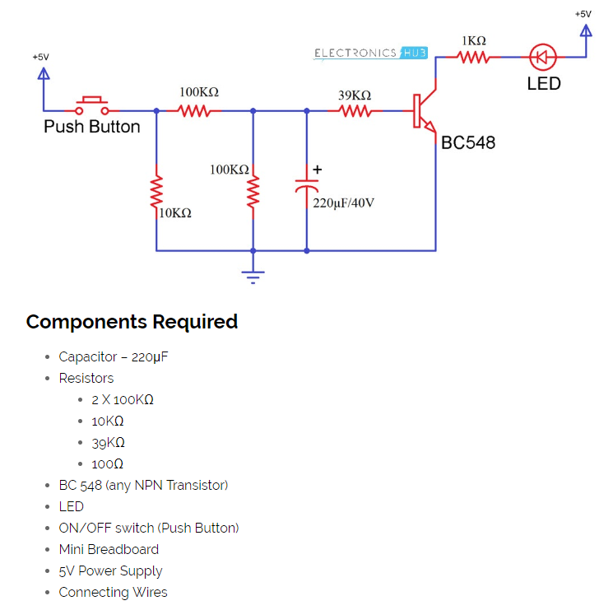
Typical Schematic/BOM Issues
40V? 6V would be fine
Resistor power rating?
What kind of LED?
What kind of switch?
Power supply current?
Wall wart?
Lab supply?
Source: https://www.electronicshub.org/updown-fading-led-lights/

Slide 7
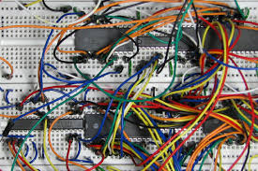

Practicality of Breadboarding
Source: https://www.build-electronic-circuits.com/build-blinking-light-circuit/

Slide 8
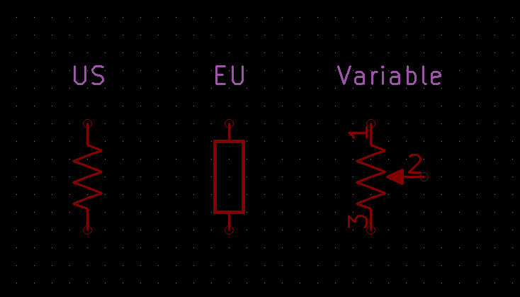
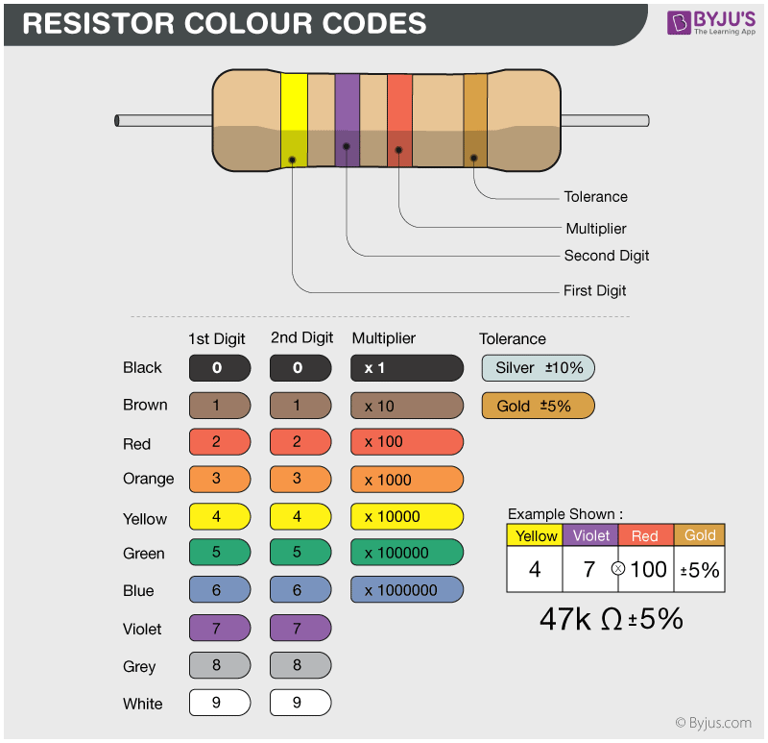
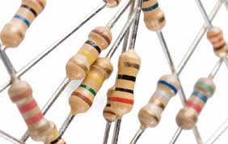
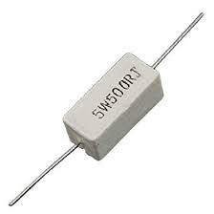
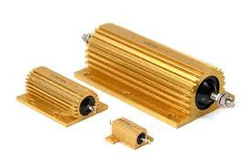
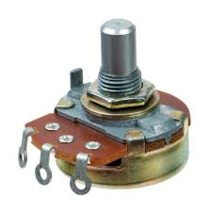
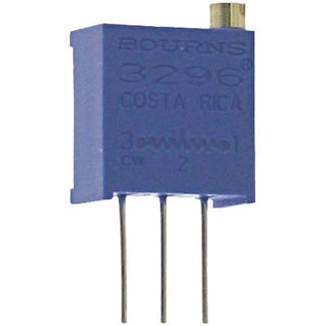
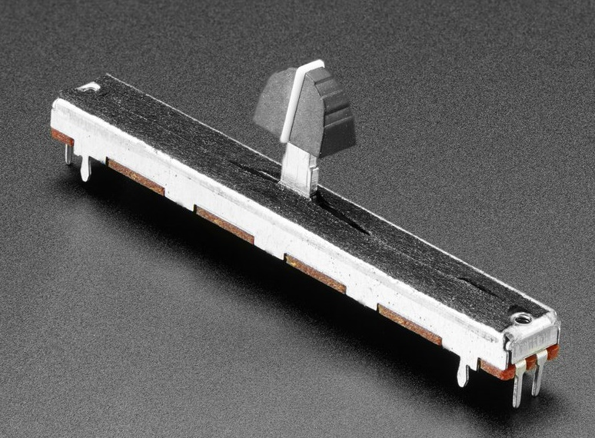
Resistors
If not otherwise specified,
> 1/8W of these work
Fixed Value
Variable/Potentiometer

Slide 9
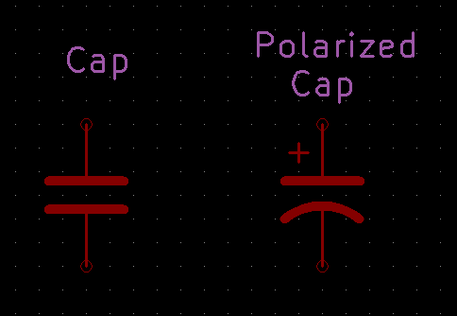
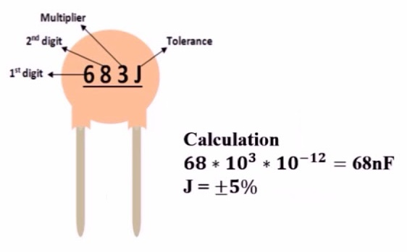
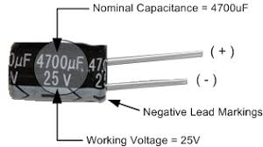
Capacitors
Polarity:
Stripe
Lead Length (short is negative)
Other marking

Slide 10
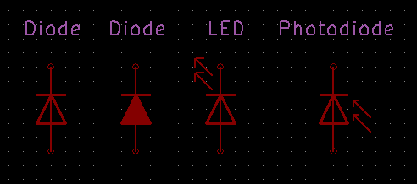
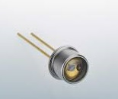
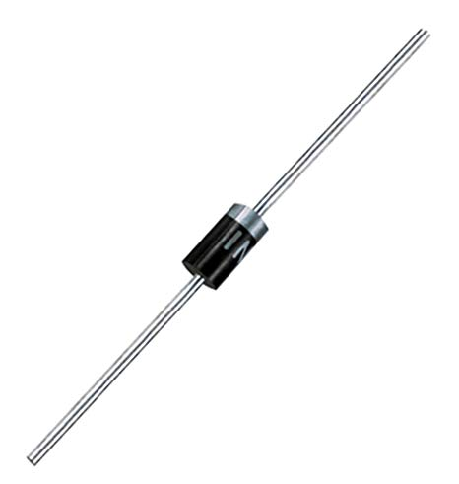
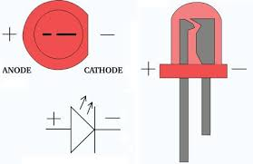
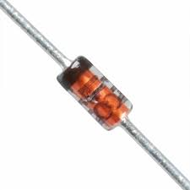
Diodes (Always Polarized)
Polarity:
Band
Lead Length
Flat Edge

Slide 11
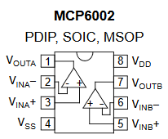
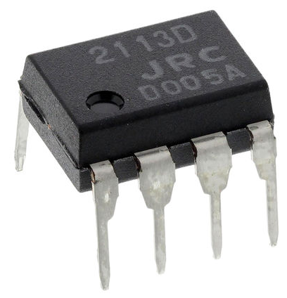
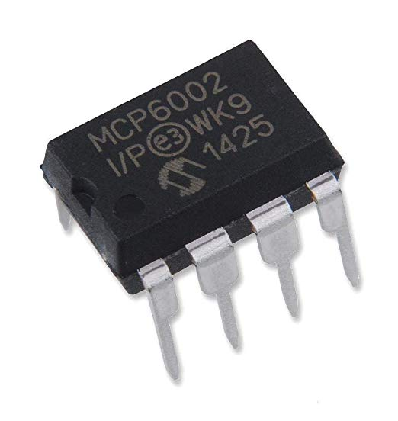
ICs (Always Polarized)
4
4
2
3
2
3
1
1
Semicircle
Depression
Dot or
Round Depression

Slide 12
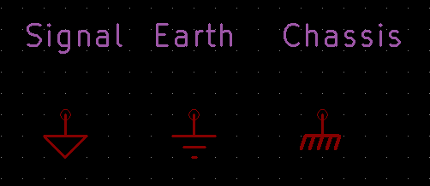
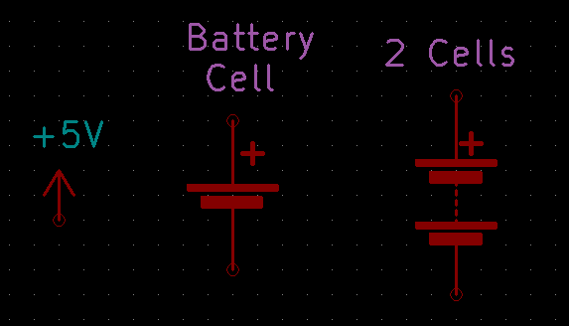
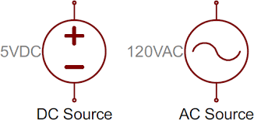
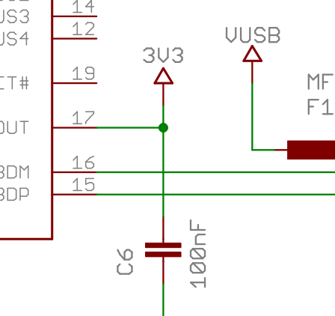
Other Common Schematic Symbols
Grounds
(Used Imprecisely)
Sources
(Used Imprecisely)
Connected
Not Connected

Slide 13
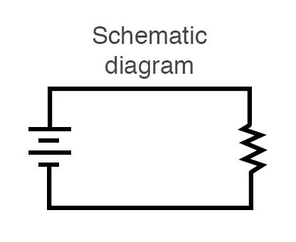
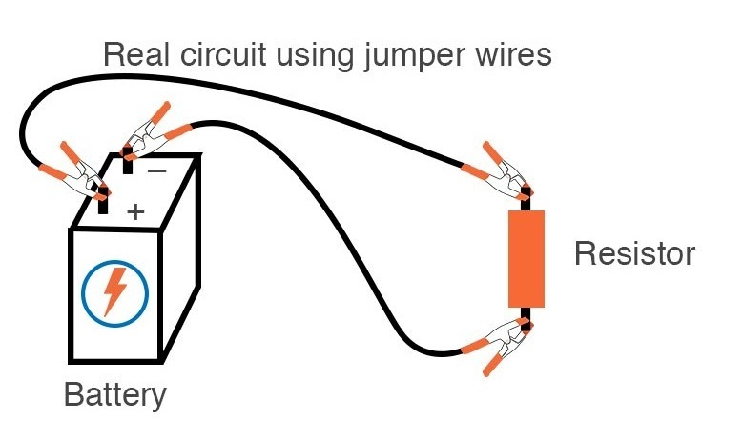
What’s a Schematic ISN’T: Physical Implementation
Image source: allaboutcircuits.com

Slide 14
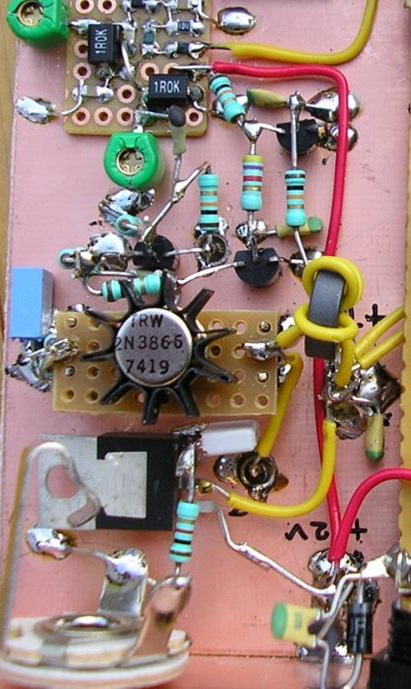
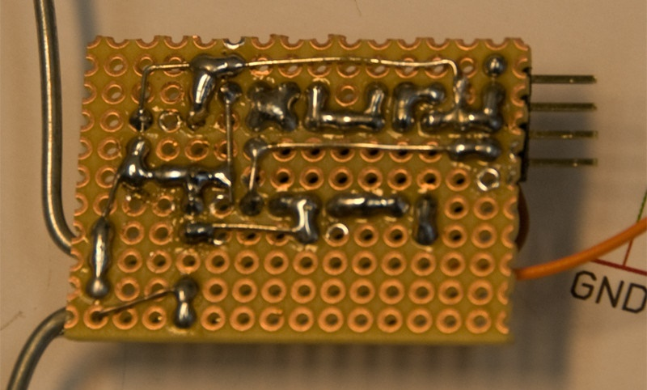
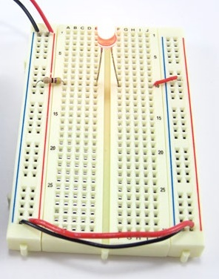
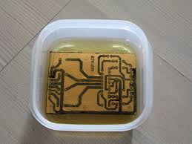
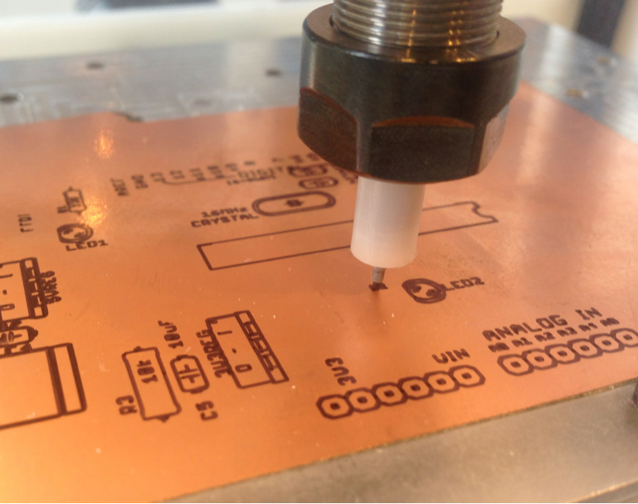
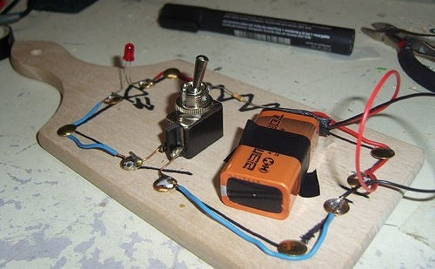
Prototyping Techniques

Slide 15
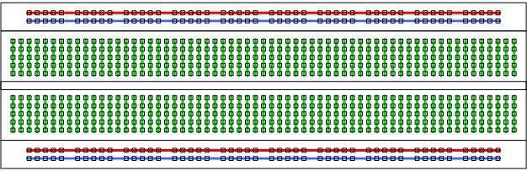
Using a Solderless Breadboard
Power Supply Buses
Circuit Connections

Slide 16
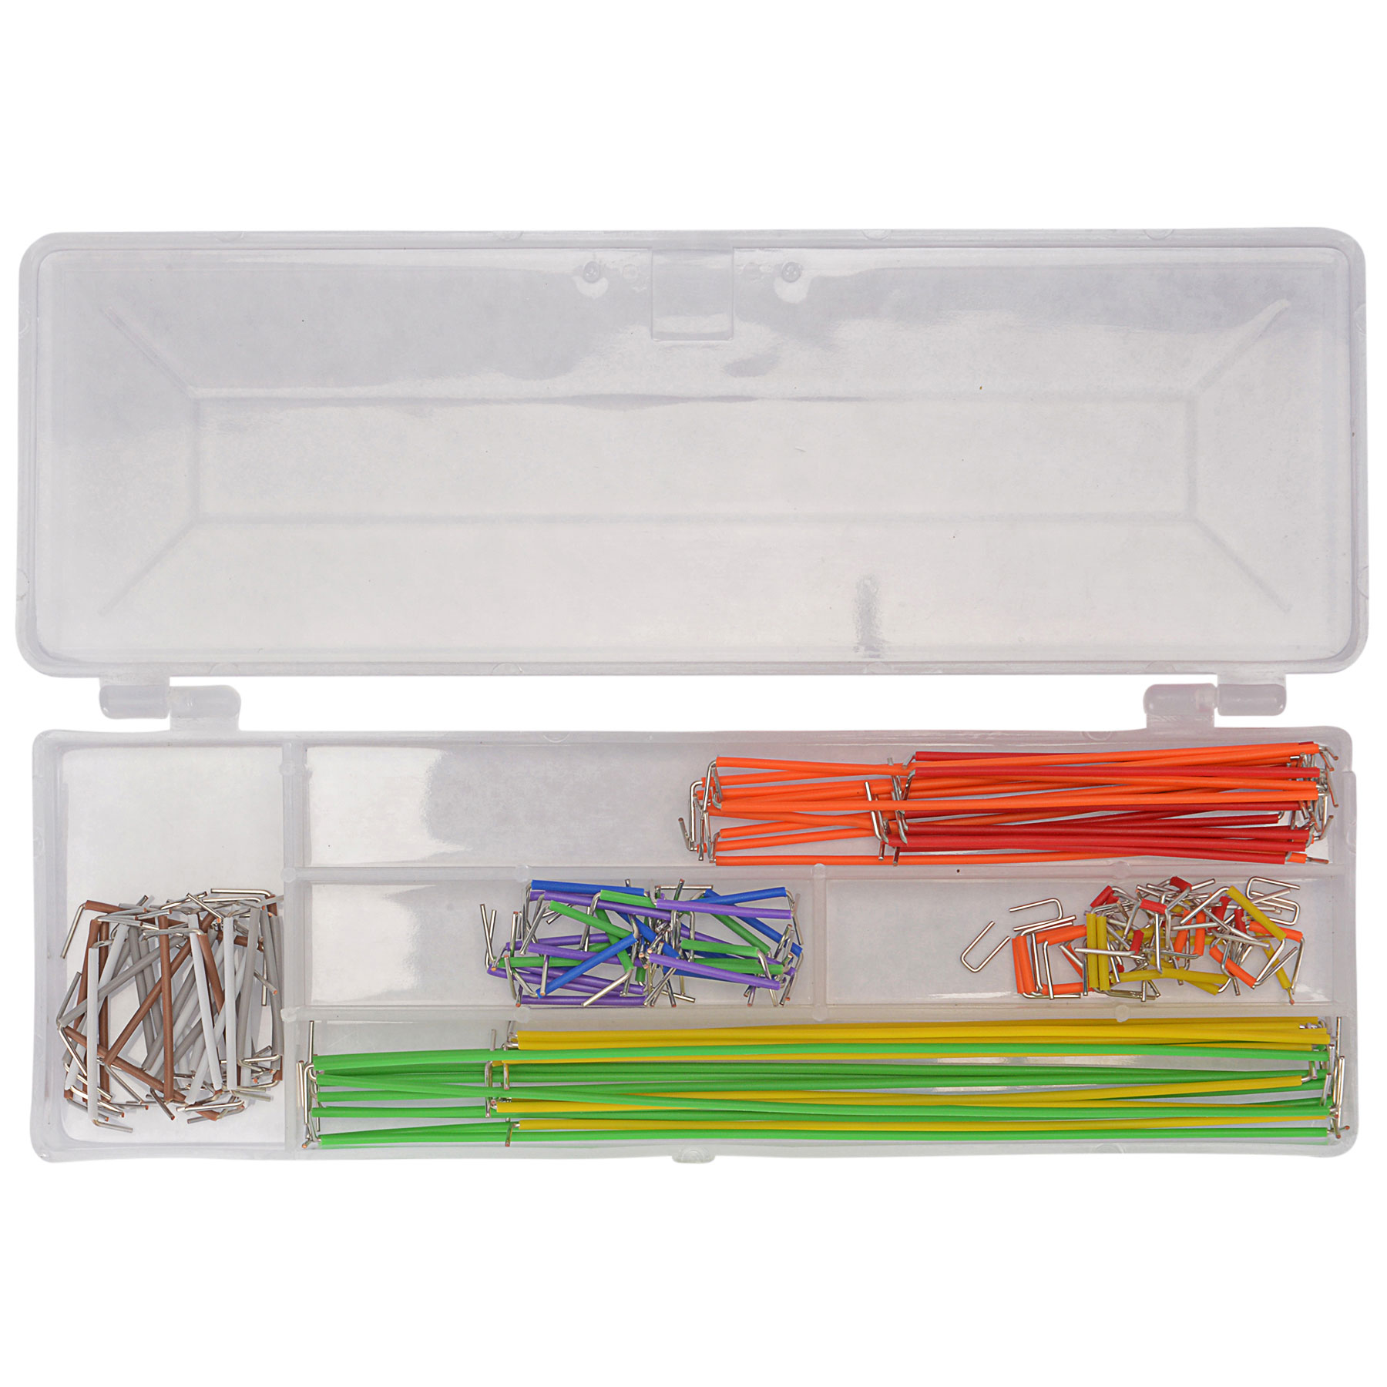
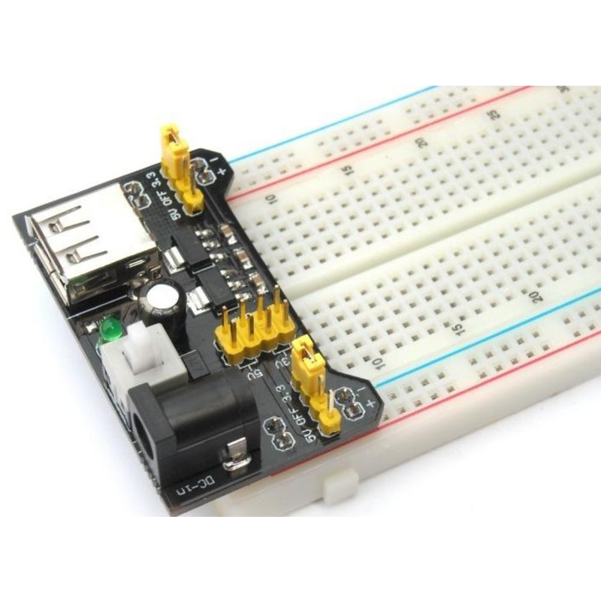
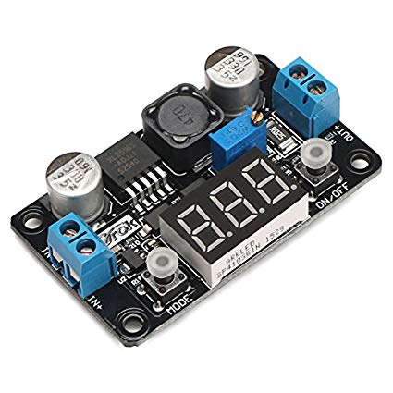
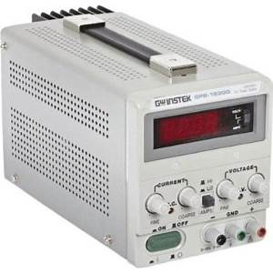
Things You Need for Breadboarding
Breadboard
Jumper Wire Kit
Power supply(ies)

Slide 17
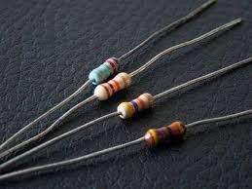
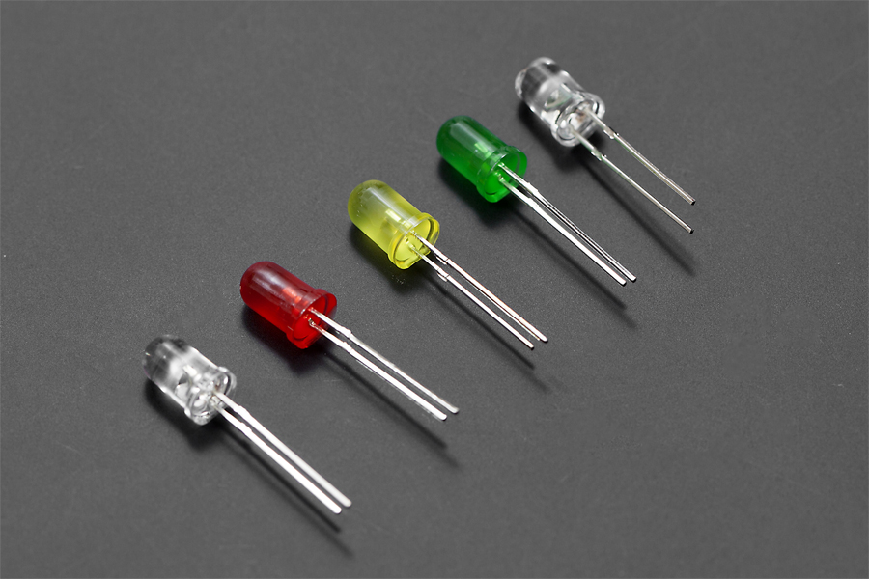
Let’s Build a Circuit
R₁ 200Ω, 1/8W
5V
+
-
A
D1, LED
C

Slide 18
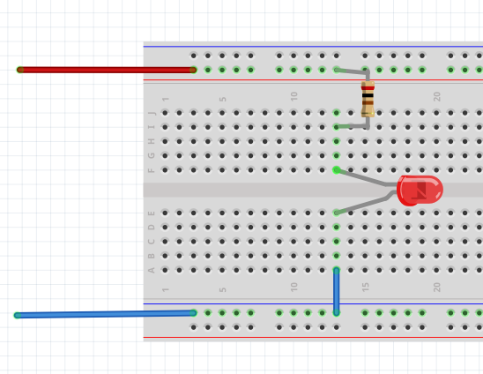
Let’s Build a Circuit
R₁ 200Ω, 1/8W
5V
+
-
A
D1, LED
C

Slide 19

Build an Oscillating Blinker
C₁ = 1µF
5V
R₂
D₁ = LED
R₃
5V
R₁ = 120kΩ
3
8
R_{2,3,4} = 47kΩ
+
U1
1
R₅ = 200Ω
R₄
2
-
R₅
U₁ = MCP6002
4
A
D₁
R₁
C
C₁
$$f≈ 1/{2R1C1}$$

Slide 20
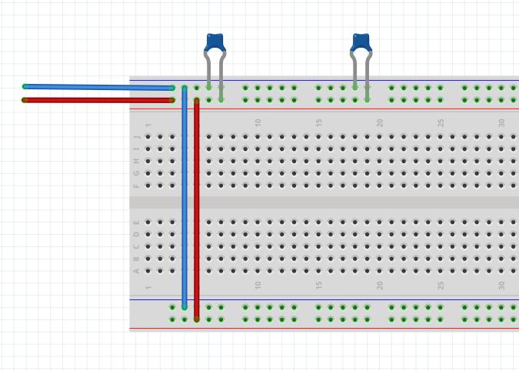
Set Up Power Supply Rails
10µF cap where supply enters
0.1µF capacitors near integrated circuits
Tie alike colored supply rails together

Slide 21
Build an Oscillating Blinker
C₁ = 1µF
5V
R₂
D₁ = LED
R₃
5V
R₁ = 120kΩ
3
8
R_{2,3,4} = 47kΩ
+
U1
1
R₅ = 200Ω
R₄
2
-
R₅
U₁ = MCP6002
4
A
D₁
R₁
C
C₁
$$f≈ 1/{2R1C1}$$

Slide 22
Build a x3 Amplifier
5V
V_{IN}
8
3
+
V_{OUT}
MCP6002
1
2
-
4
R₁
R_{f}
R₂

Slide 23
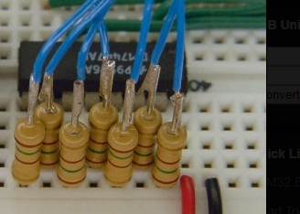
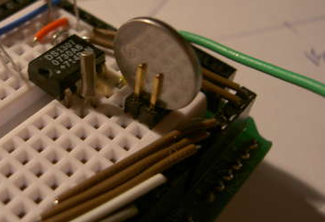

More Hints and Tips
Power Supplies
Watch power supply polarity!
Connect the two power rails to each other
Add a large (10F) bypass where power comes in
Add 0.1µF bypass to each rail, near supply pins
Trim component leads so they don’t short into each other
Dupont wires make cheap, long jumpers
Drop an LED and resistor on the board to use as a logic probe

Slide 24


